Slide 1
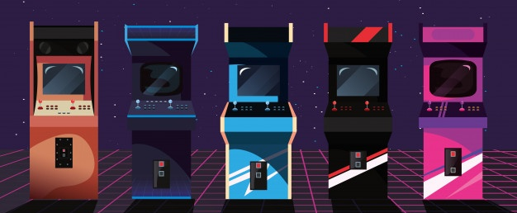

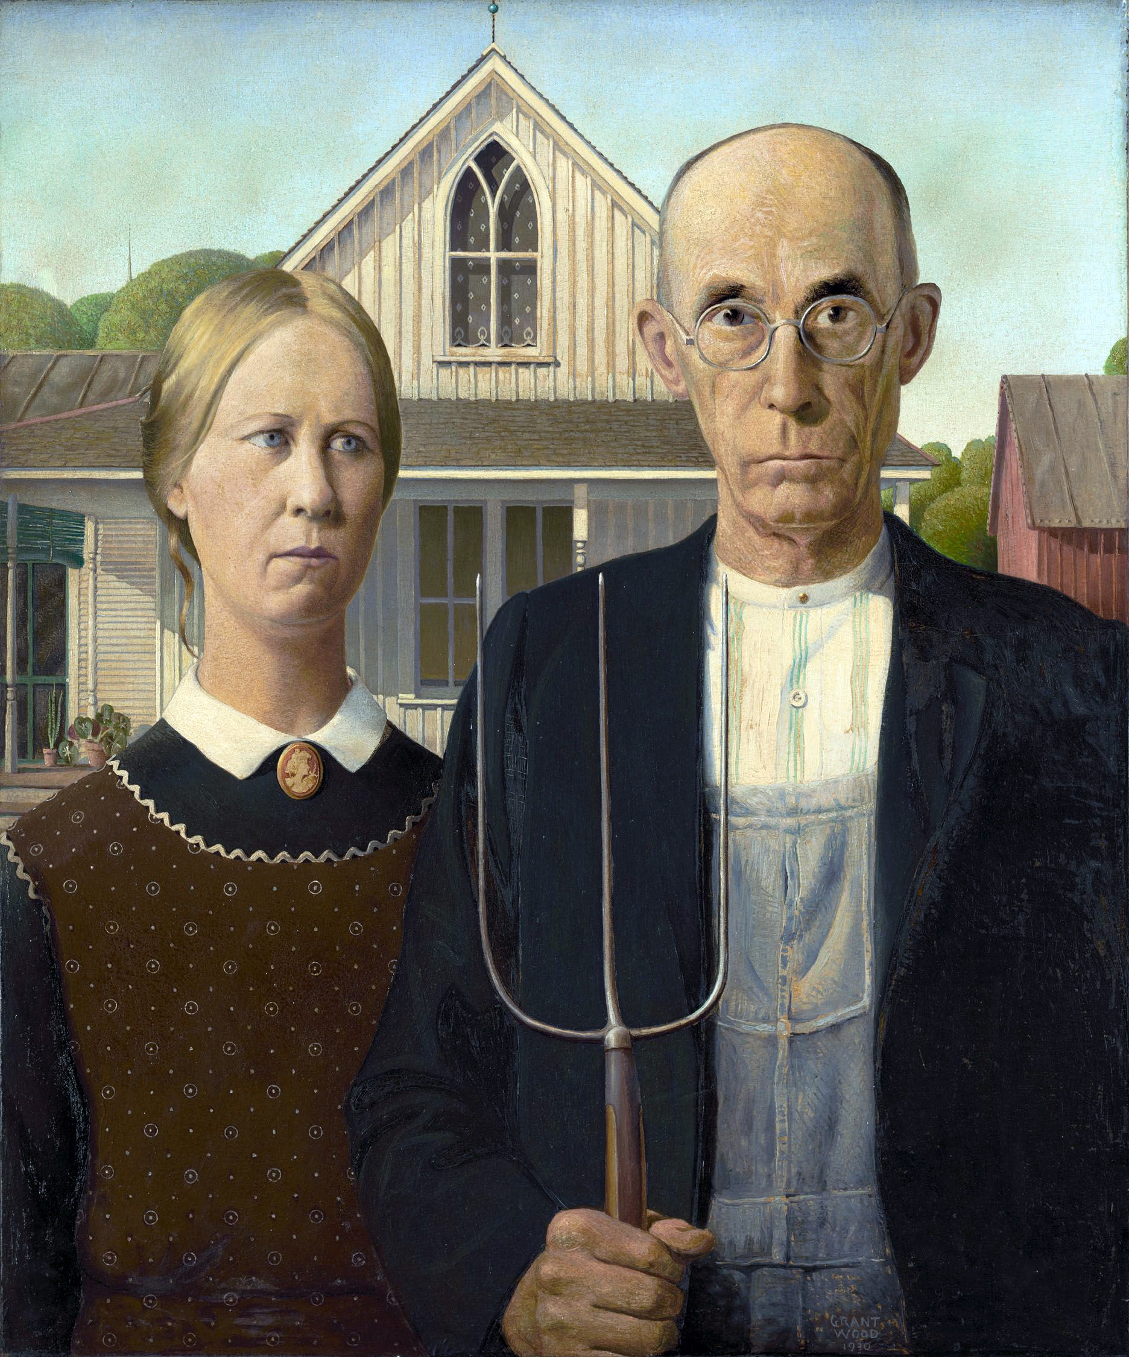
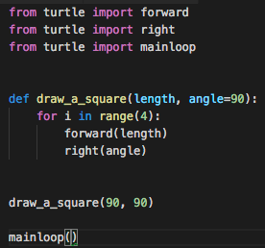
CAPTAIN CODER

Slide 2


Team Members
Hossein Zinaghaji
Ali Vaseghnia
The Team
The Team
Artist - Game Designer - Tester
Game Designer - Programmer - Tester
Notes:
Hi everyone, I'm [Name1] and I'm here today with my teammate, [Name2] to talk to you about the serious game we have been developing, [Captain Coder].
As you can see, we are a team of two, and we have both worked closely in game designing and testing this game. With that being said, Hossein is also taking the role of Artist and I’m the Programmer of this game.

Slide 3
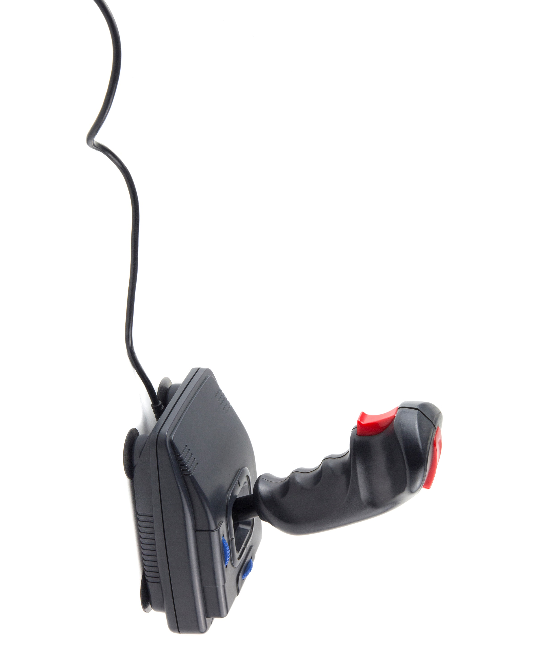


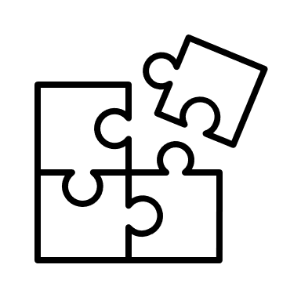
Game Genre
Serious Game
Programming
Puzzles
Notes:
So, let’s talk about the game and its genre a bit. As we all know, the goal in this project has been to design a serious game to teach basic programming concepts to grade 11 and 12 high-school students. Our game is designed to help students learn ”if statements” and “for loops” by solving fun puzzles. We haven’t really focused on a specific programming language in this game, instead, we want to make sure the students understand the underlying concepts of scenarios where they need to use ‘if statements’ or ‘for loops’ when they’re coding.
The students will learn these concepts by drawing shapes and solving fun puzzles. We will get into more details in the next slides.

Slide 4
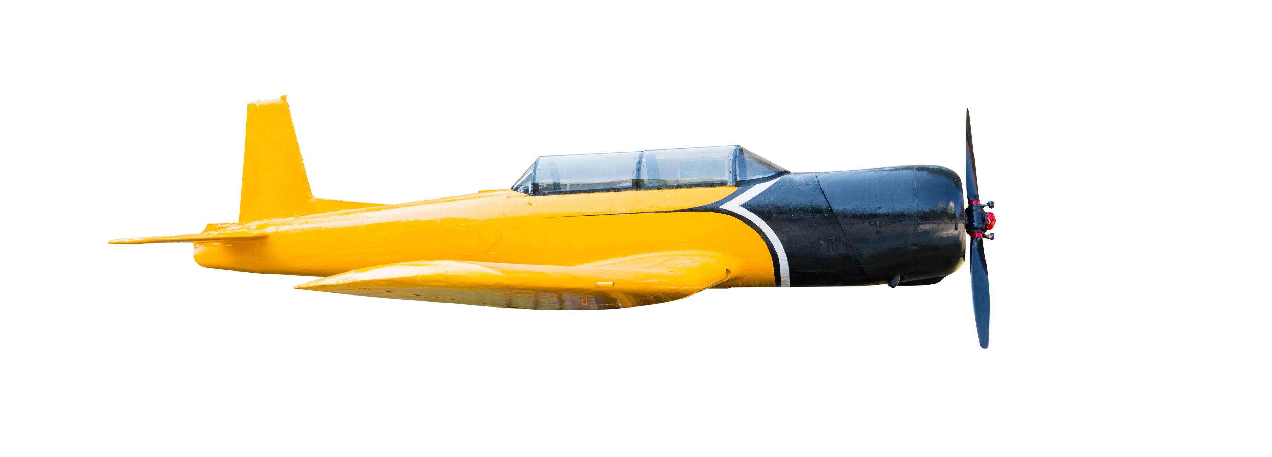
Storyline
Welcome Aboard, Captain!
Notes:
Now, let’s get into the storyline of the game. We have put a lot of thought in making a game that has a good balance between entertainment and education. In [Captain Coder], you start as a beginner pilot who is on their journey to learn flight maneuvers. In each level of the game, you have an objective to complete a flight by creating a pattern in the sky. As you finish each level, the patterns will become harder to create. But don’t worry, you can unlock new planes and jet aircrafts by leveling up in the game.
But you might be asking, how are we going to implement the characterizing goal in this game?

Slide 5
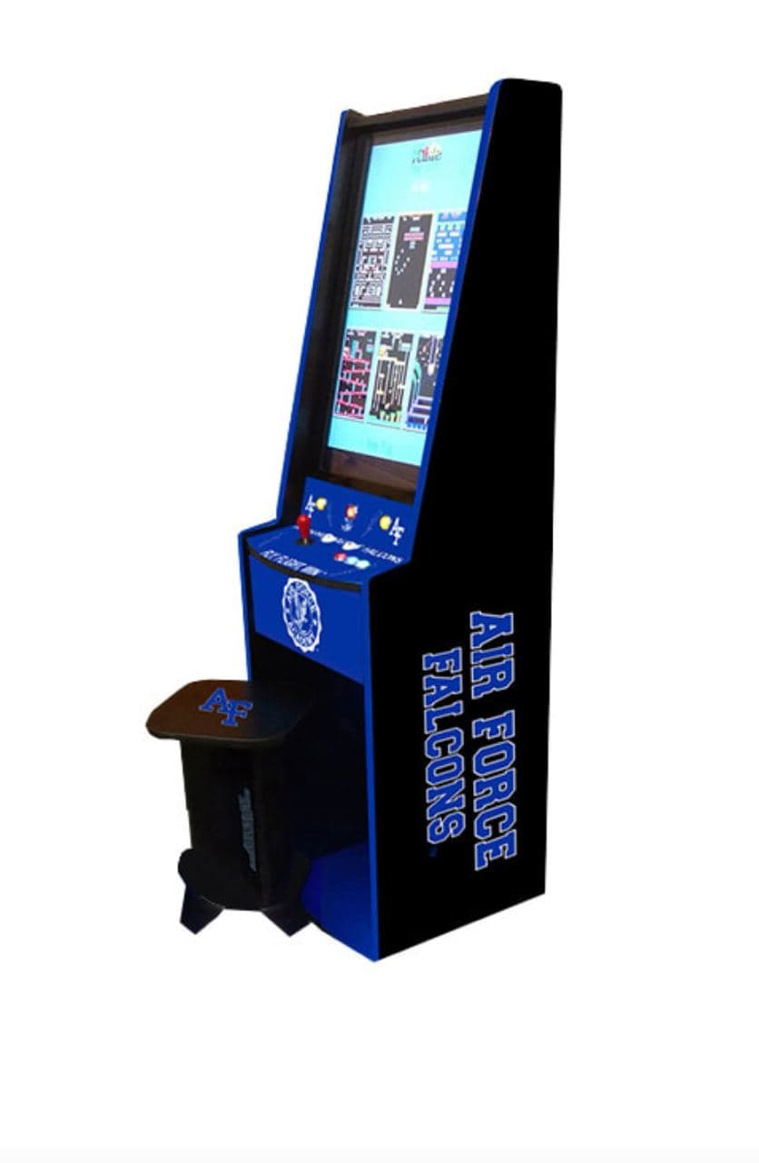
What do these shapes have in common?
Notes:
To answer this question, let’s have a look at these shapes. What do you think these shapes have in common?
Many of the shapes that we learn in school are created by repeating patterns. For anyone who knows programming, the term repeat has a strong meaning. And what is a better way to teach students not to repeat themselves than asking them to draw the shapes they’re already familiar with?

Slide 6

Example
Start:
moveForward(100);
turnRight(90);
moveForward(100);
turnRight(90);
moveForward(100);
turnRight(90);
moveForward(100);
turnRight(90);
End
for (i=0; i <= 3; i++) {
moveForward(100);
turnRight(90);
}
Notes:
Let’s look at a simple example of we can integrate these programming concepts into a drawing game.
Let’s say the plane is starting its flight from the top-left corner, where the little arrow is, and wants to draw a square! To draw this particular shape, the player needs to move forward and change the plane’s direction by 90 degrees four times to return to its starting point and draw a square.
This can be done with a for loop, where you can iterate through the loop four times and repeat the moveForward and turnRight functions 4 times.
The same concept can be applied to show how if statements work. In the same example, you can ask the player to draw Another square on the opposite direction IF the plane has returned to its original location.
As you can see, this can start with very simple problems. As the player level ups in the game, more complicated shapes that require different combinations of ‘if statements’ and ‘for loops’ are introduced to the player.
What we really like about this method of learning, is that it helps you visually see the results of each of this programming concepts.
Hossein will now tell you more about the details of how the game works.

Slide 7
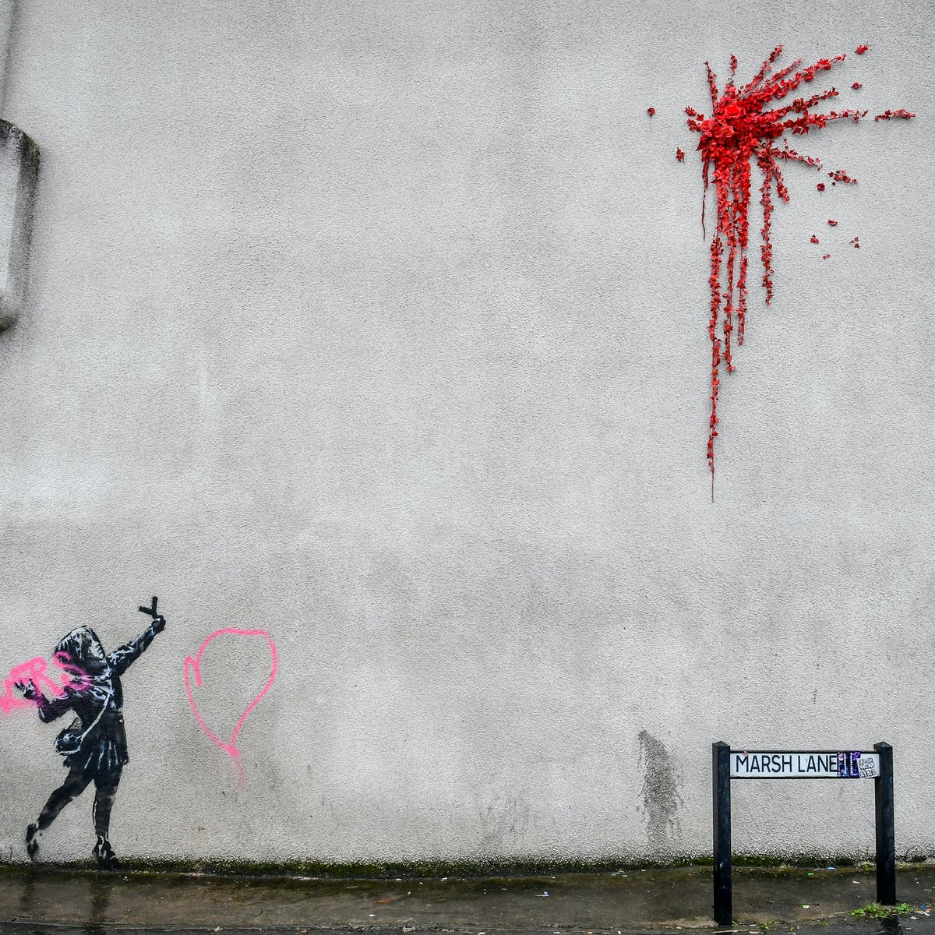
Game World
40s
70s
2000s
Notes:
Flights take place in different maps, that have the same feel and look of the era that the plane belongs to. As you can see, the game takes place in three different time periods.
We are going to have matching planes and music for each era. The player will start in the 40s and as they level up, the game world changes accordingly. You can think of it as the Rise of Nations equivalent of serious games!

Slide 8

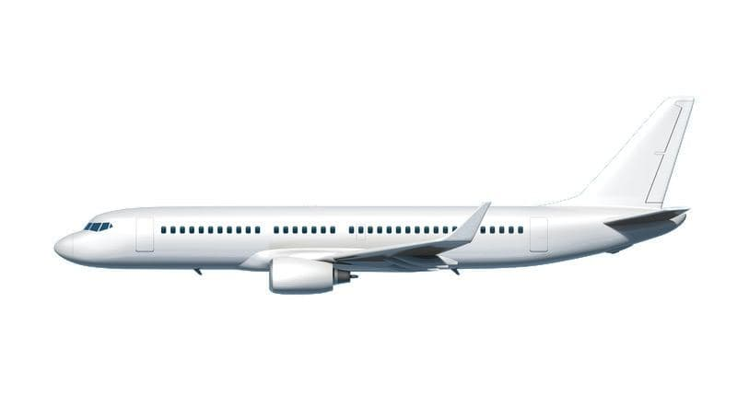
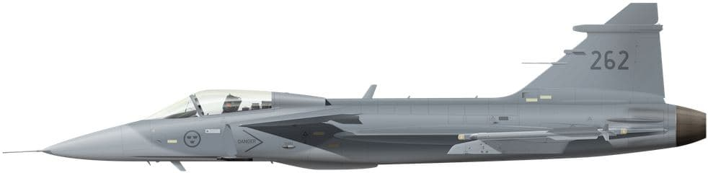
Planes
Rookie
Intermediate
Advanced
Notes:
We are using the same idea for the planes in the game. The three main levels a player is going to experience are Rookie, Intermediate, and Advanced.
As the planes upgrade, the games become more difficult and user has to draw more complicated patterns.

Slide 9

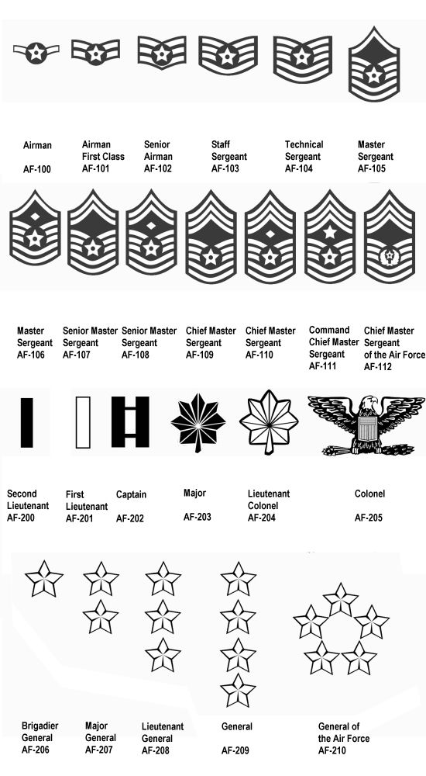
Motivators
0-Beginners
5-Beginners
10-Medium
15-Medium
20-Advanced
25-Advanced
30-Advanced
Notes:
The motivators in [Captain Coder] are the medals and badges that the player receives after completing each level. Also, player’s rank increases as they successfully complete more advanced levels of the game.

Slide 10

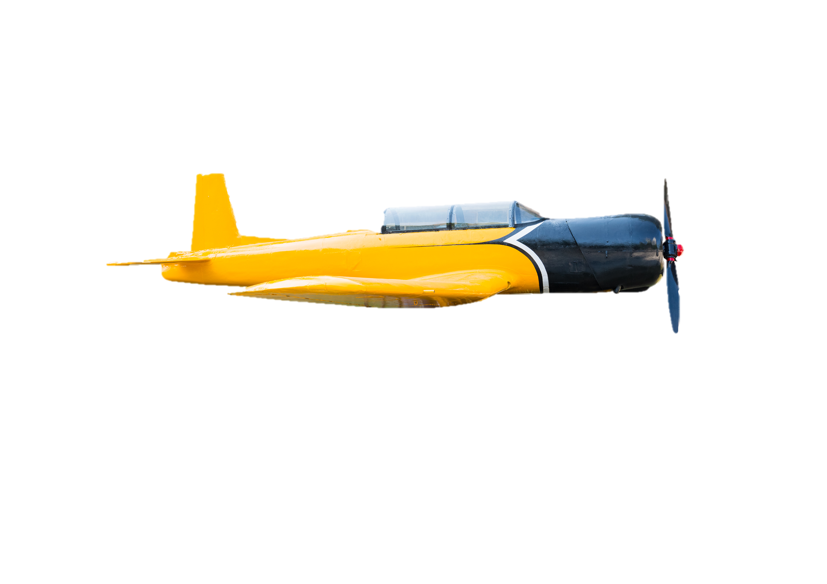
for (i=0; i <= 3; i++) {
moveForward(100);
turnRight(90);
}
turnRight(90)
turnLeft(90)
i++
for
if
moveForward(100)
i=1
i=0
i <= 3
moveBackward(100)
i <= 4
Help
Notes:
We are going to add two levels of difficulty to the game. In the beginner levels of the game, the player can finish a level by dragging and dropping the right block of code to the correct spot in the code.
So, if you think about it, the shape in the picture can be easily drawn using a for loop. After putting all the blocks in place, the player can then run the code and see the results of the flight.

Slide 11
for () {}
Type Here
Notes:
As the player continues with their learning, less hint will be shown to them and eventually in the advanced level, the player must type the code from scratch. The game also features a “Hint” button where the player can get help if they are stuck at a level.

Slide 12
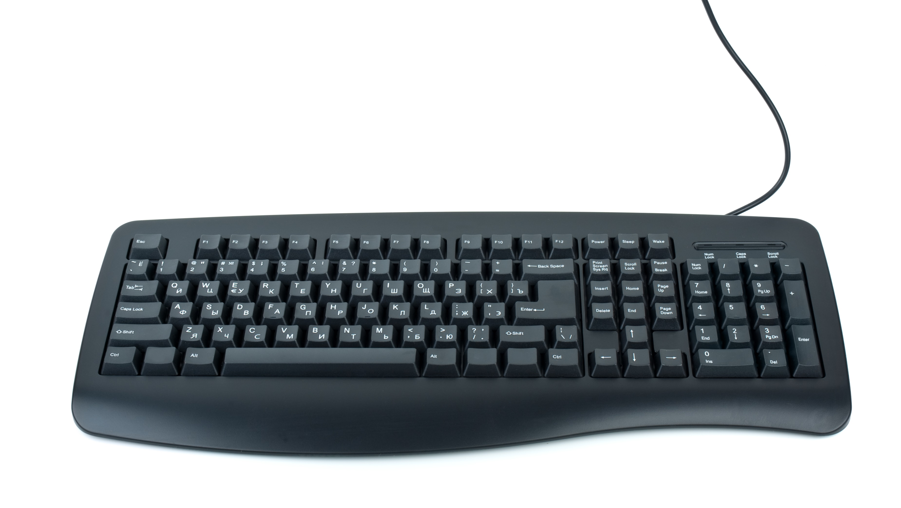

Game Control
Typing
Advanced
Drag and Drop
Beginner and Medium
Notes:
Both Keyboard and mouse inputs will be used for game controls in the [Captain Coder] game.
As discussed earlier, the beginner and medium levels, will be played by drag and dropping the code blocks using mouse.
In the advanced levels of the game, the player will use keyboard input to type in the code.

Slide 13

Conclusion
Notes:
[Captain Coder] is our first attempt to build a game and we are excited to build a game that can potentially be used as a learning tool. There is a lot of potential in what can be done when it comes to serious games and we are looking forward to hearing other teams’ game implementation ideas. We hope you found the [Captain Coder] game interesting.

Slide 14
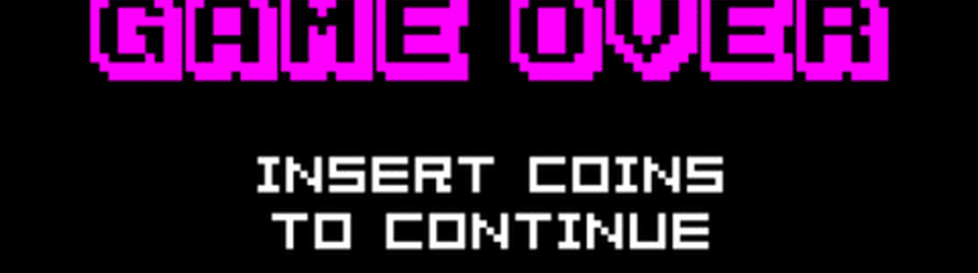
Thank you!
Questions?

